Slide 1
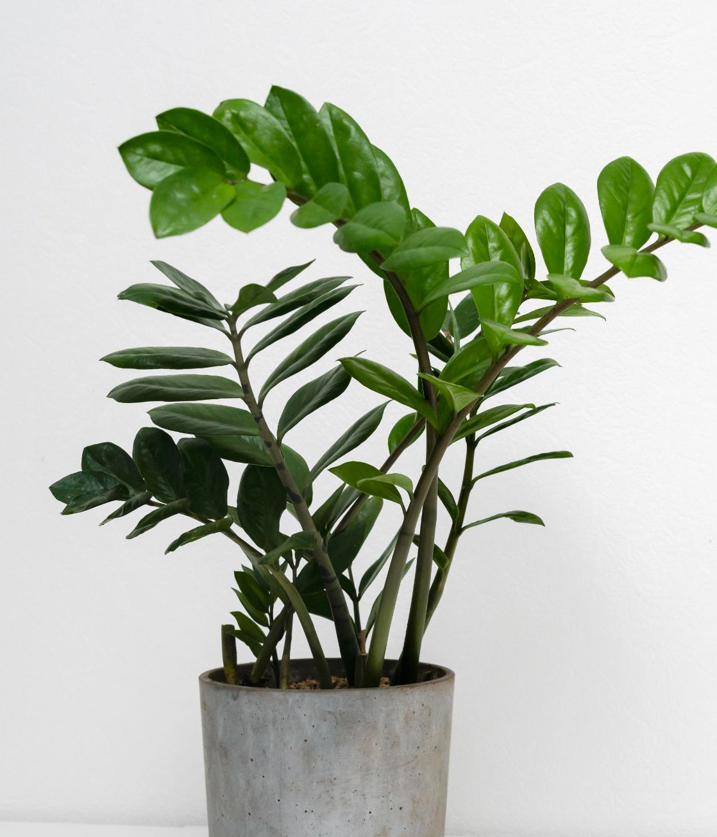
Saveyourplant
CUlTYVATE
PRESENTED BY TEAM: Terminators
Niranjan Hebli
Samridhi Kapoor

Slide 2
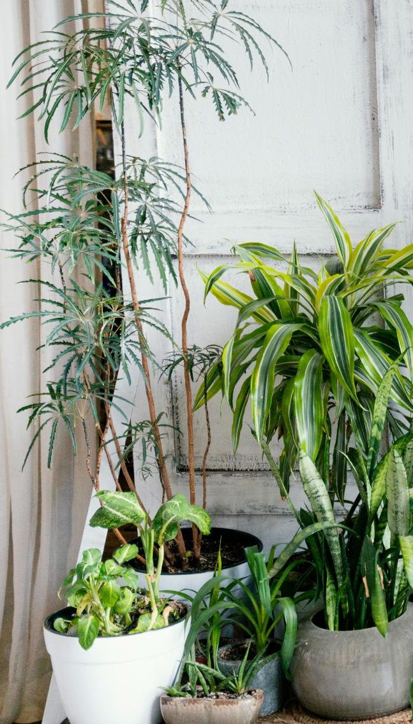
TABLE OF CONTENTS
01
02
INTRODUCTION
ABOUT OUR MODEL
03
04
OUR WEB APPLICATION
SUMMARY

Slide 3
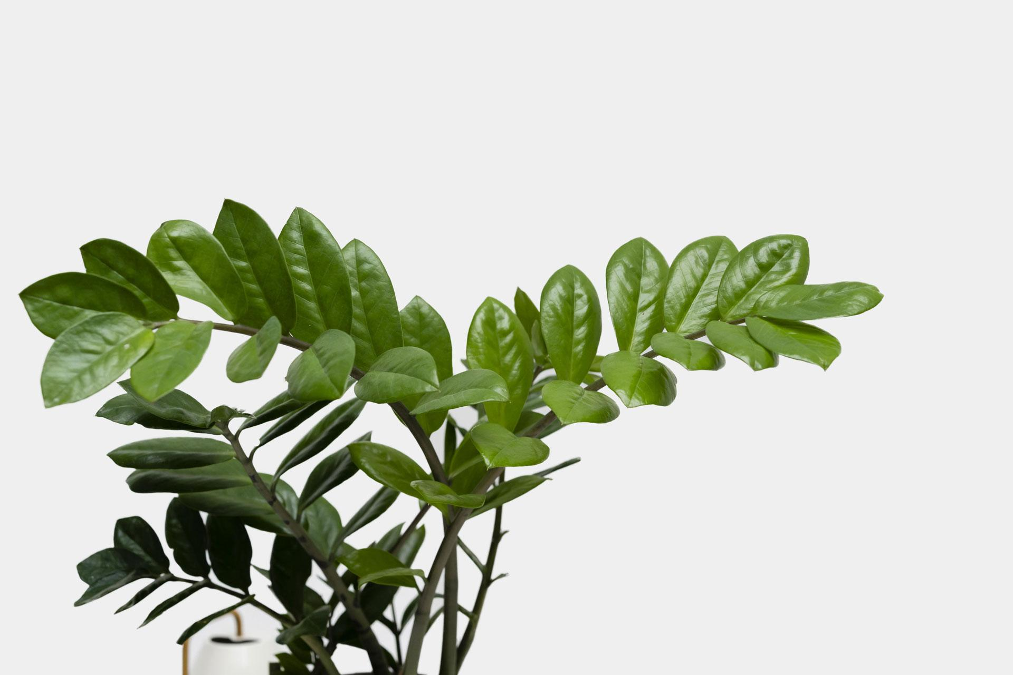
THE PROBLEM STATEMENT
Create a working model which will inculcate the latest ML-AI cutting-edge technologies to help farmers combat the pest control problem without human intervention in the farm field. Also,TO BE ABLE TO find the most suitable fertilizer that should be given to the crop to ensure a healthy harvest. TO BE ABLE TO provide suggestions to the farmers about which crop is the best to grow in a particular area by taking into consideration various parameters like water content, mineral composition, amount of salinity present in the soil.

Slide 4
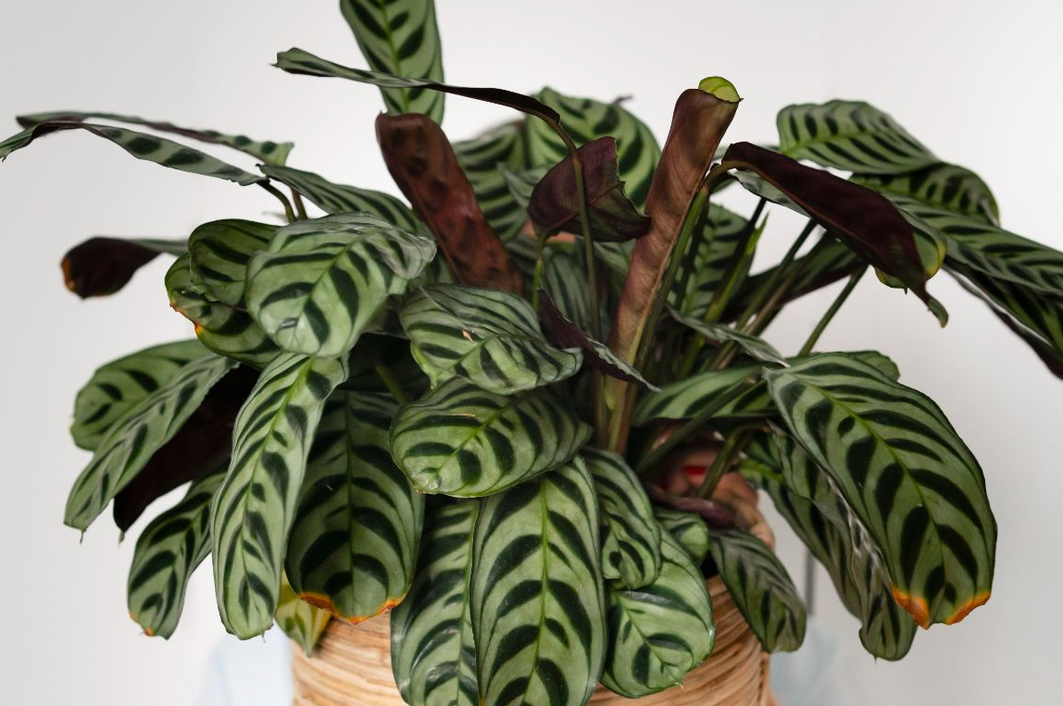
INTRODUCTION
Plant disease can directly lead to stunted growth causing bad effects on yields.
An economic loss of up to $20 billion per year is estimated all over the world.
In addition, traditional methods mainly rely on specialists, experience, and manuals, but the majority of them are expensive, time-consuming, and labor-intensive with difficulty detecting precisely.
Therefore, a rapid and accurate approach to identify plant diseases seems so urgent for the benefit of business and ecology to agriculture

Slide 5
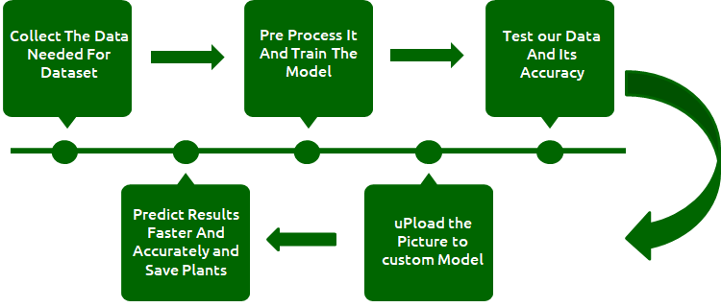
APPROACH TOWARDS THE SOLUTION
mercury
venus
mars
jupiter
saturn
NEPTUNE
Mercury is the closest planet to the Sun
Venus is the second planet from the Sun
Mars is actually a very cold place
Jupiter is the biggest planet of them all
It’s composed of hydrogen and helium
Neptune is the farthest planet from the Sun

Slide 6
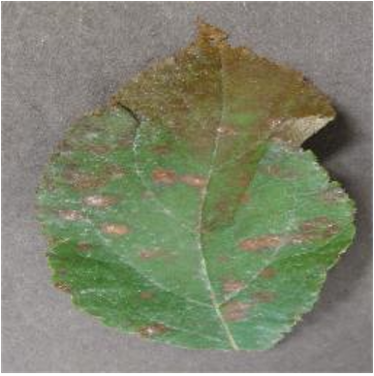
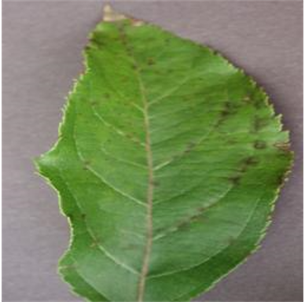
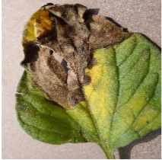
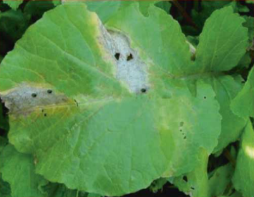
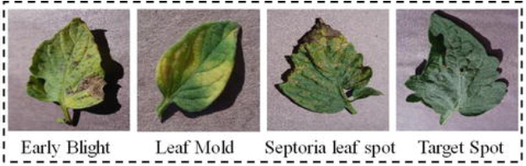
OUR DATASET
For training and testing purposes, we used the standard open-access PlantVillage dataset, which consists of 54,305 numbers of healthy- and infected-plant leaves. Detailed database information, the number of classes and images in each class, their common and scientific names, and the disease-causing viruses. The database contains 38 different classes of 14 different plant species with healthy- and disease-affected-leaf images. All images were captured in laboratory conditions.

Slide 7
OUR DATASET
Fertilizer prediction dataset downloaded from the Kaggle, has the following parameters - Temperature, Humidity, Moisture, Soil Type, Crop, Nitrogen, Potassium, Phosphorous, Fertilizer Name,

Slide 8
WHY OUR MODEL ?
ACCURACY
The main advantages of our solution include high processing speed and high classification accuracy. A plant disease recognition system can work as a universal detector, recognizing general abnormalities on the leaves, such as scorching or mold. However, our further research is related to precise recognition of particular diseases.
SINGLE STEP PROCESSING OF THE OUTPUT
In real time scenario, farmers suffer a huge loss of crop and money as the crop gets spoilt because of the attack caused by pests etc. Our model on the other hand, provides just a single time uploading of an images and detection of the disease striking off the scope for crop failures.

Slide 9
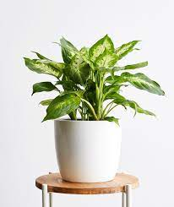
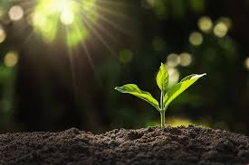
SAVING MONEY AND CROP HARVEST
An economic loss of up to $20 billion per year is estimated all over the world as they go undetected.Our model provides timely detection of tumors thereby saving a million lives. It is estimated that 84,170 people will receive a primary diagnosis of plant disease in 2021 with the aid of our model.
TIME SAVER APPROACH
The detection is a single step easy process which is done by our pre-trained model, that will contribute to saving the precious time.
FLEXIBLE DATASET
The dataset used is quite flexible that corresponds to standardized and globally accepted results as per agricultural researchers all over the globe.

Slide 10
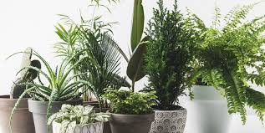
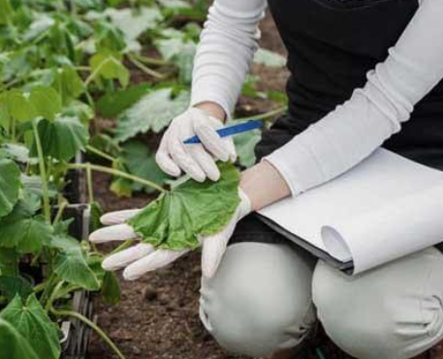
APPLICATIONS
The Main Aim of the Custom model is to Identify that whether the plant is diseased or not. Other than that, it helps to predict which crop would be suitable to grow based on the concentration of minerals like N,P,K ,the pH level,rainfall in mm and the state and city. It also gives advice about the fertilizer to be used, based on the soils composition, concentration of N,P and K) and the type of crop.
The manual identification is not so fast, accurate and efficient. Therefore to overcome these challenges a custom model is designed by us.

Slide 11
CONCLUSION
In this work, we developed a deep convolutional neural network (CNN) based on a recently developed ResNet CNN model. The model was fine-tuned and trained for the detection of healthy and different unhealthy crop leaf images. The obtained results show that our model out performs some recent deep learning techniques by using the most popular publicly available Plant Village dataset and the fertiliser prediction dataset.

Slide 12
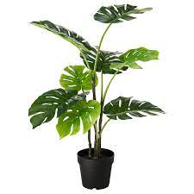
RESULTS
We have successfully implemented, executed and tested our model
In the best model scenario it provides an accuracy up to 94.47% that is far beyond the reach of manual testing
For further development and improvement of our model and idea, we have deployed our model by creating a web application with a user friendly interface that could further simplify the process for the user.

Slide 13
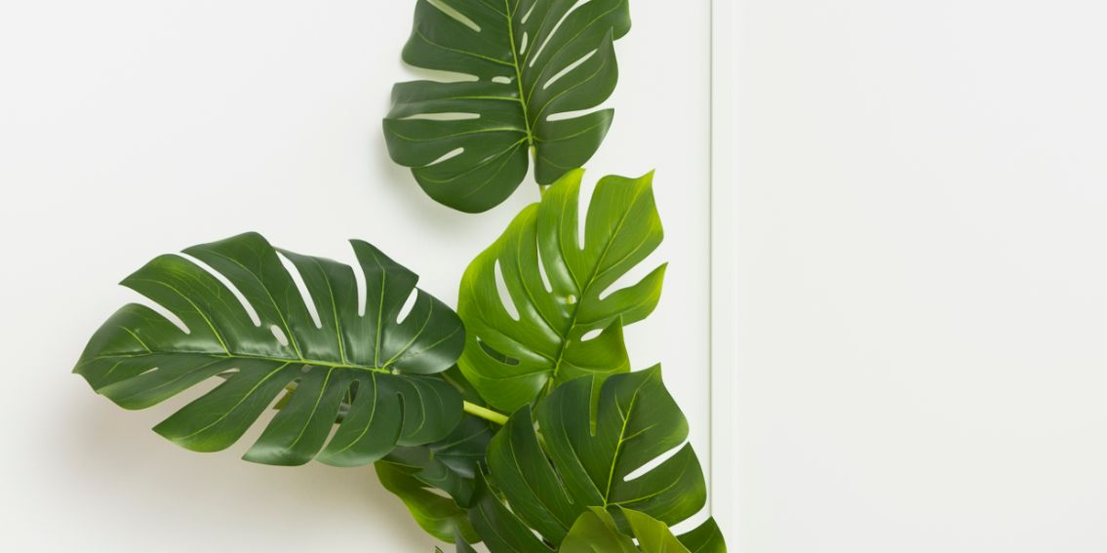
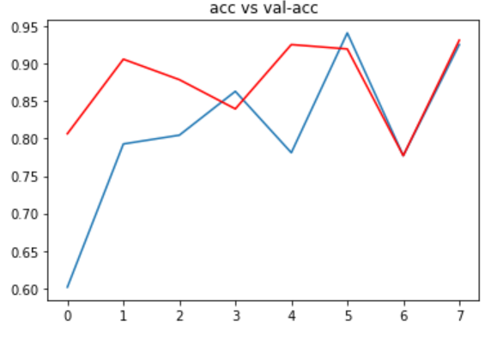
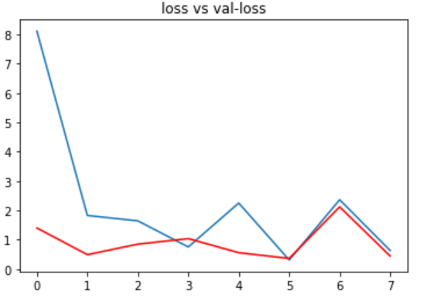
Graphs
Accuracy vs Val-Accuracy
Loss vs Val-Loss

Slide 14

A GLIMPSE OF
OUR WEB APPLICATION
PLANT AI-DISEASE DETECTOR

Slide 15
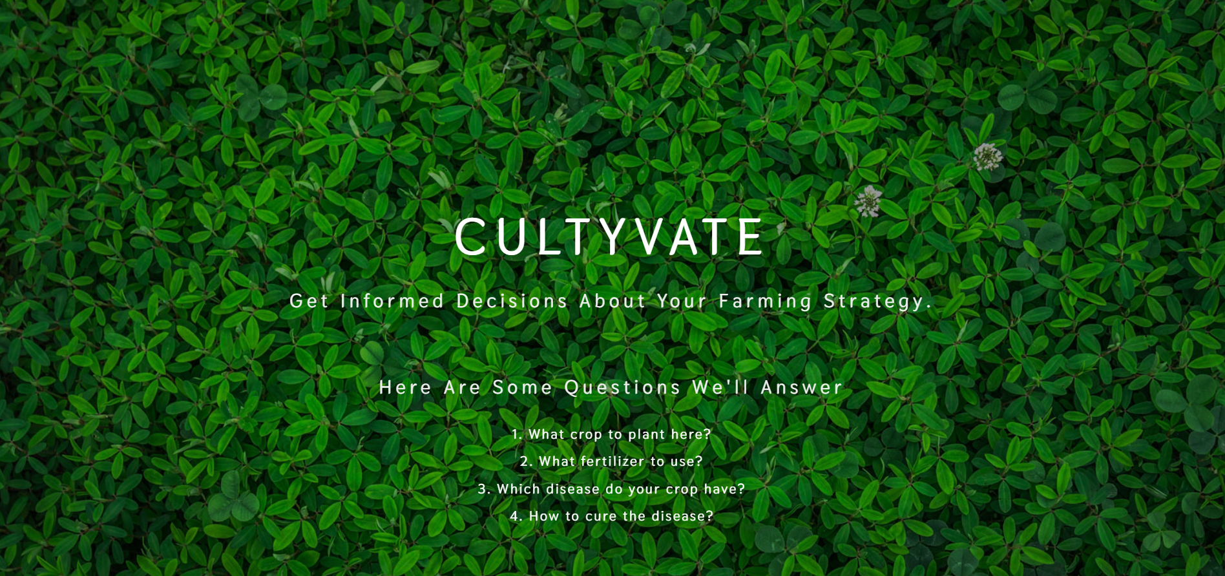
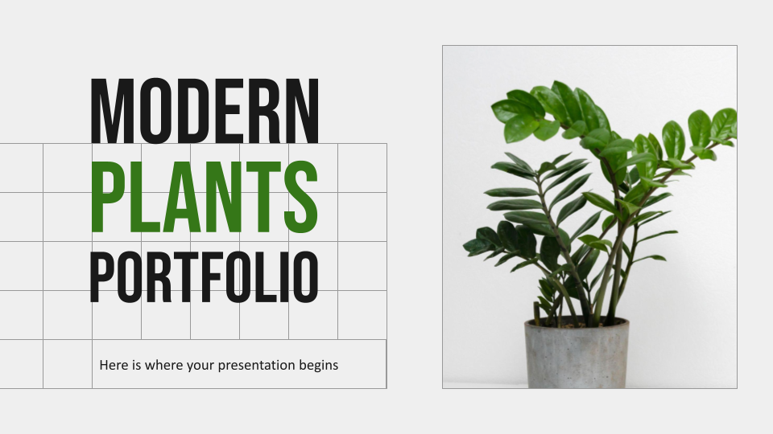
MY WEBSITE
HOME PAGE
You can replace the image on the screen with your own work. Just right-click on it and select “Replace image”

Slide 16
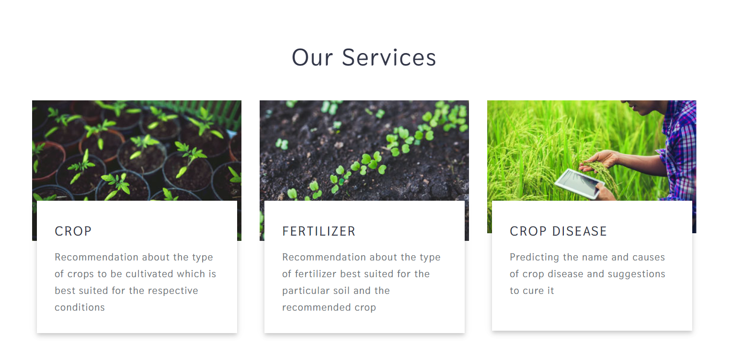
MY WEBSITE
uploading image
You can replace the image on the screen with your own work. Just right-click on it and select “Replace image”

Slide 17
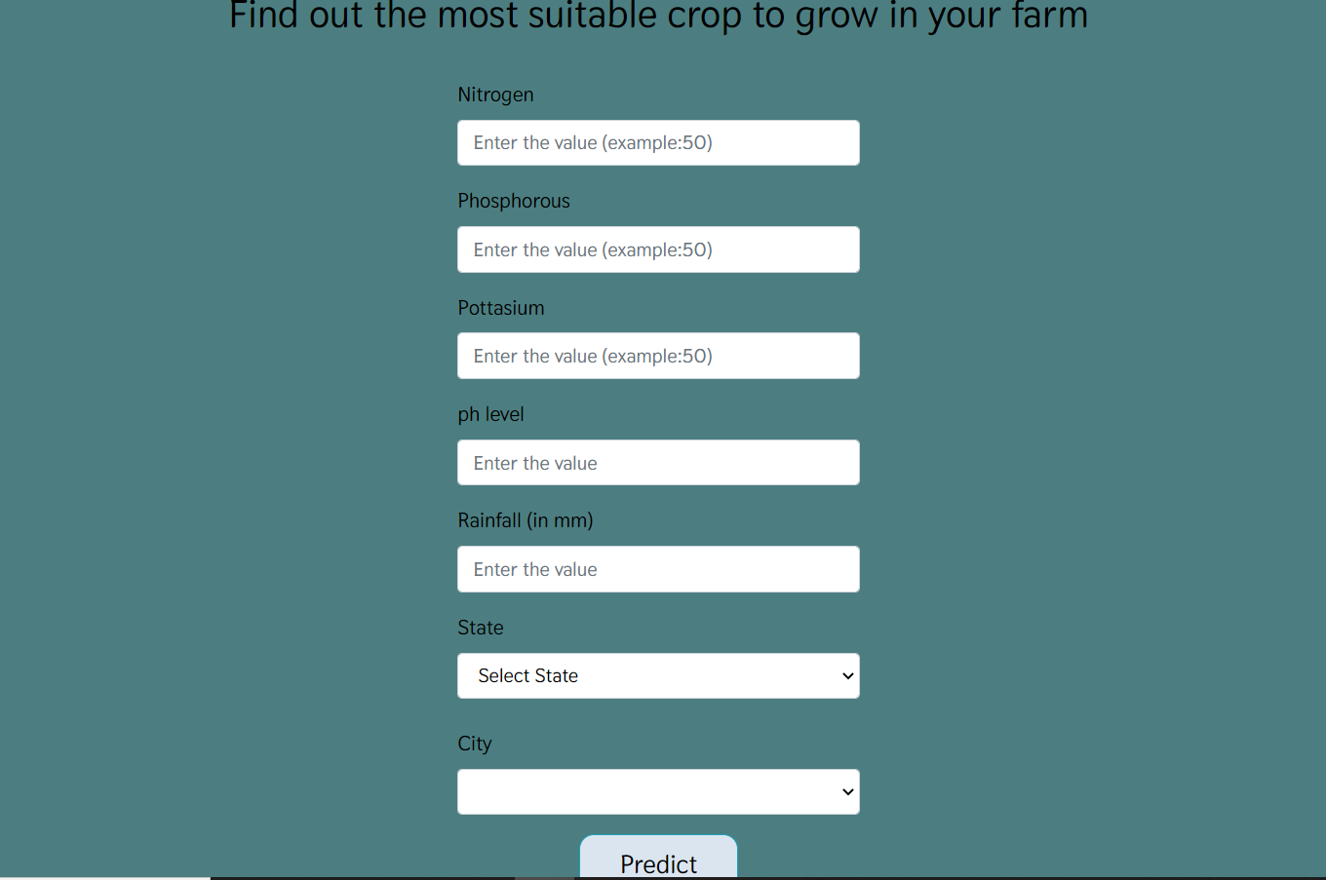
MY WEBSITE
CROP PREDICTION PAGE
You can replace the image on the screen with your own work. Just right-click on it and select “Replace image”

Slide 18
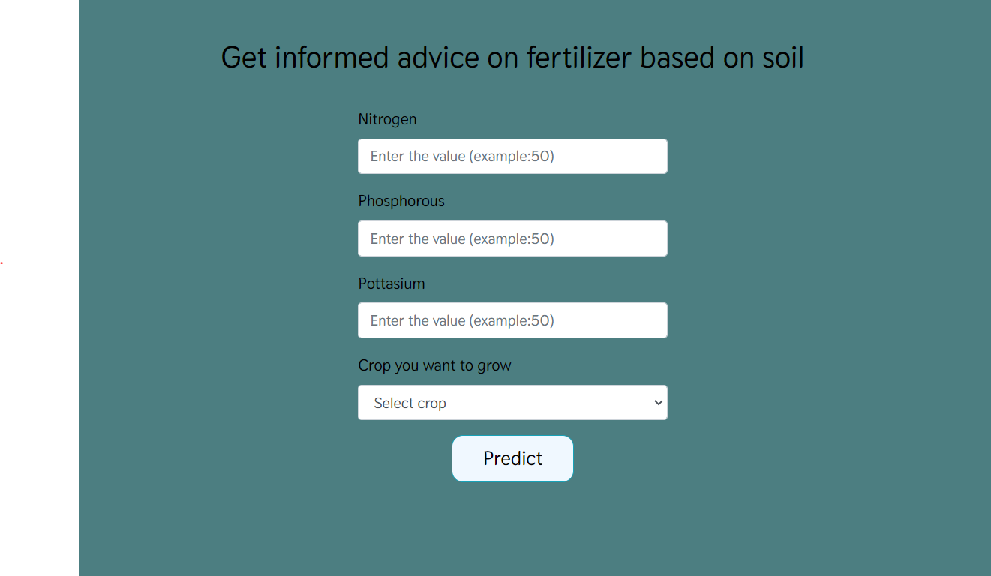
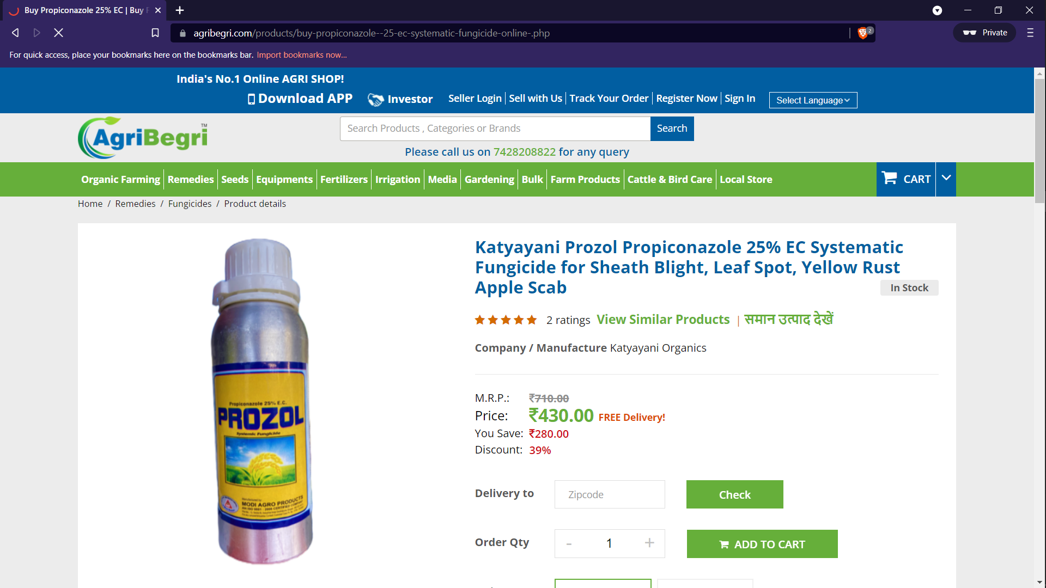
MY WEBSITE
FERTILISER recomendation PAGE
You can replace the image on the screen with your own work. Just right-click on it and select “Replace image”

Slide 19
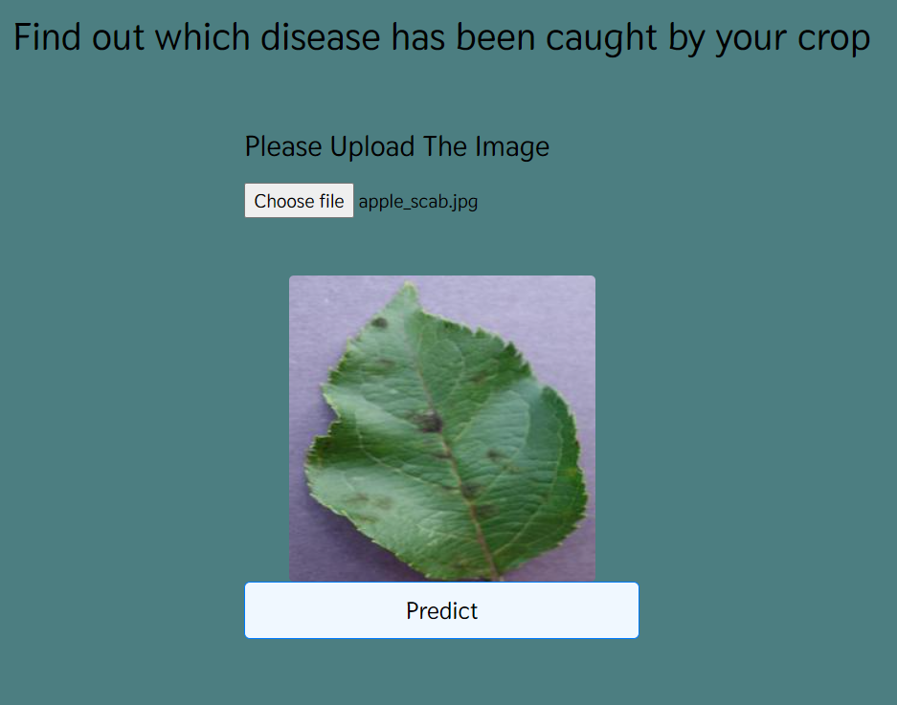
MY WEBSITE
DISEASE DETECTION PAGE
You can replace the image on the screen with your own work. Just right-click on it and select “Replace image”

Slide 20
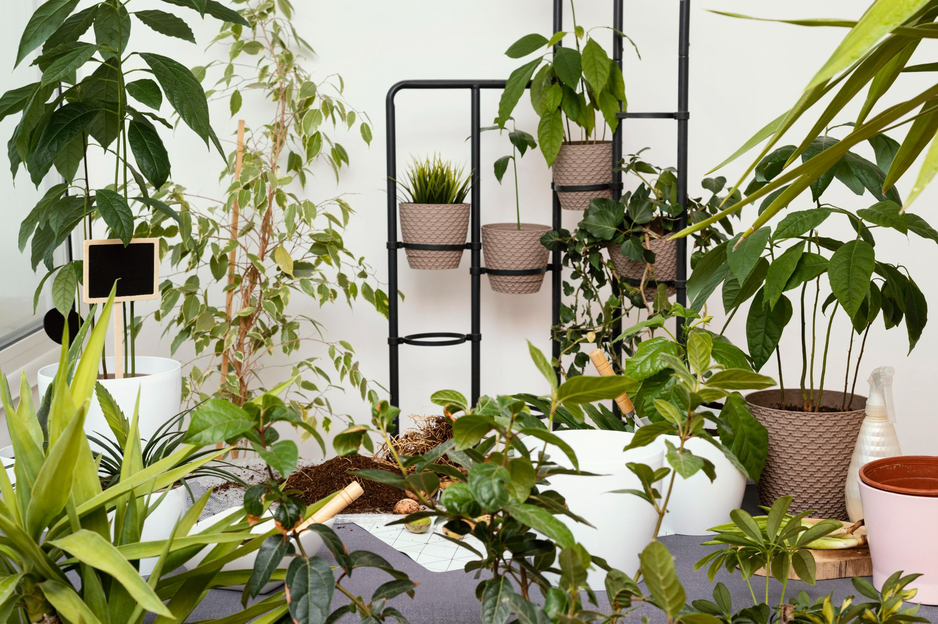
STEPS TO USE THE THE WEB APP
1
2
3
4
CLICK ON THE CENTRAL IMAGE IN THE BOX & UPLOAD THE image
Click on the “ANAlyze” button
APP REDIRECTS TO RESULT PAGE
THE RESULT IS DISPLAYED

Slide 21
STEPS TO USE THE THE WEB APP
1
2
3
4
ENTER THE VALUES OF N,P,K and ph of soil
ENTER THE RAINFALL RECEIVED BY THE PLACE (in mm)
ENTER THE STATE AND CITY
THE RESULT IS DISPLAYED

Slide 22
STEPS TO USE THE THE WEB APP
1
2
3
4
ENTER THE VALUES OF N,P,K of soil
ENTER THE CROP YOU WANT TO GROW
ENTER THE STATE AND CITY
THE SUITABLE FERTILIZER IS PREDICTED

Slide 23
GITHUB
VIDEO LINK
IMPORTANT LINKS
https://github.com/samridhikapoor/CULTYVATE

Slide 24
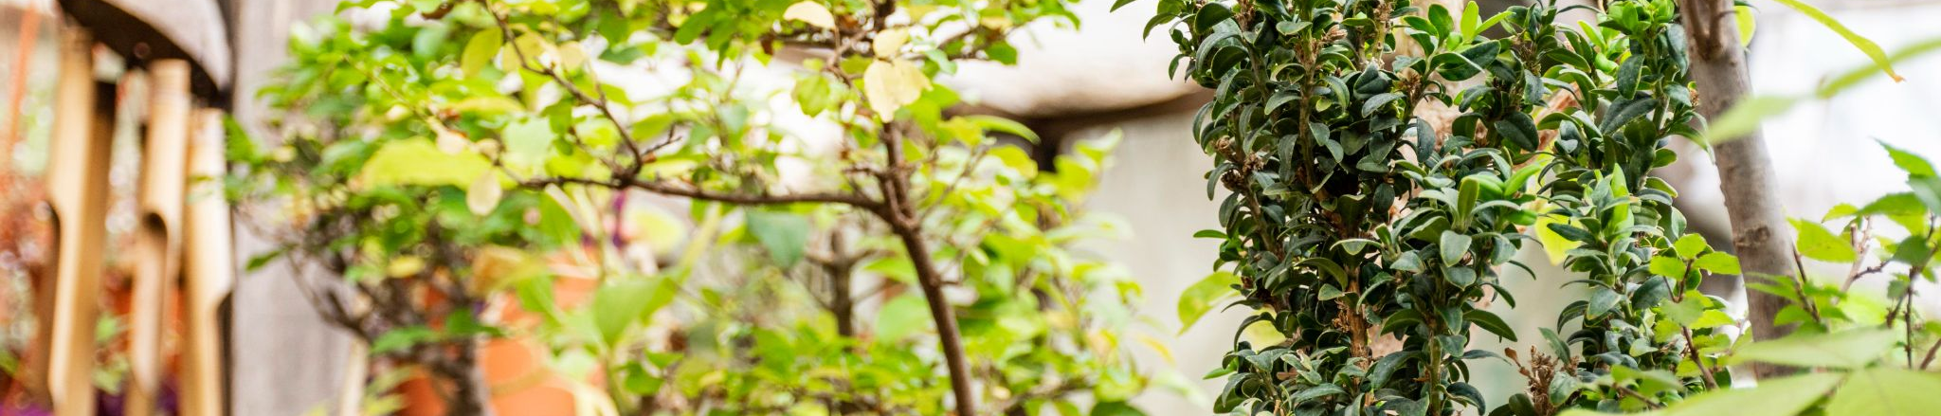
our TEAM
NIranjan HEBLI
Samridhi Kapoor

Slide 25

THANK YOU!

